Slide 1
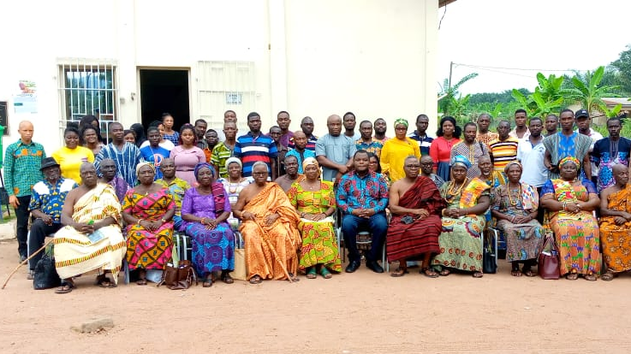
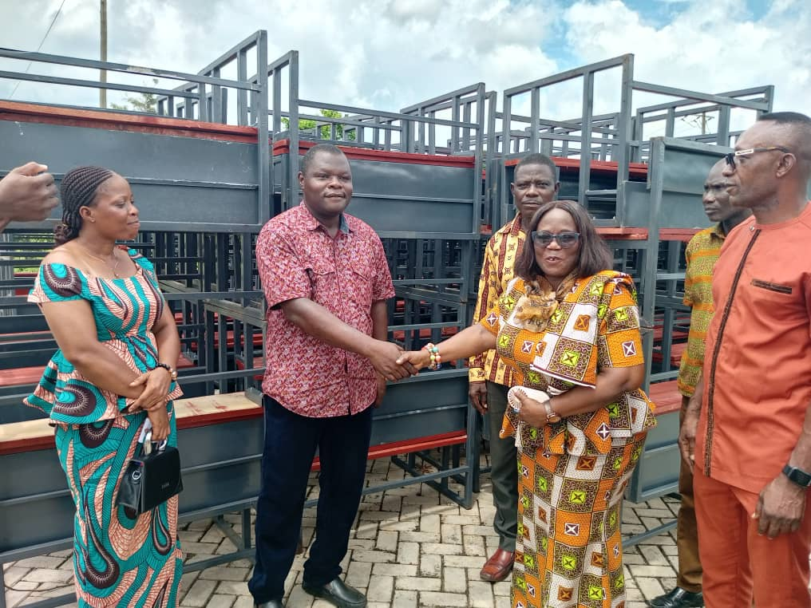

Slide 2
HO WEST DISTRICT ASSEMBLY 2025 REVENUE IMPROVEMENT ACTION PLAN (RIAP)

Slide 3
INTRODUCTION
The Ho West District Assembly was established by the Legislative Instrument, 2012 (L.I.2083) which is the highest political and administrative authority in the district. It was carved out of Ho District in January 2012 and inaugurated in June 2012. The district capital is Dzolokpuita. Ho West is located between latitudes 6.33º 32” N and 6.93º 63” N and longitudes 0.17º 45” E and 0.53º 39” E. It shares boundaries with Adaklu District to the South, Afadjato South to the North, Ho District and the Republic of Togo to the East and South Dayi District to the West. It has a total land area of 1002.79 square kilometers and a population density of 111.8, which means on the average there are about 112 persons per square kilometer in Ho West District. It has about two hundred and three (203) communities. The population of the district stood at 82,866 according to the Ghana Statistical Service 2021 Population and Housing Census (PHC) report, which comprises of 39,992 males representing 48.2% and 42,894 females representing 51.8% of the total population.

Slide 4
Objective And Expectation Of The Revenue Improvement Action Plan
The District Assembly has been in existence for Twelve years. Revenue collection has been done for the same period and the Assembly is still collecting data for revenue generation, so setting objectives needs a careful strategy. However, the main goal of the Revenue Improvement Action Plan (RIAP) is to support the Assembly’s efforts at improving, mobilization and management of its Internally Generated Revenue. This can be done by providing practical suggestions on potential interventions, activities, timelines and resources required to implement the interventions.
The expectation of the Revenue Improvement Action Plan (RIAP) is to fully harness the resource, increase local revenue mobilization and collection potential to meet the demand for service delivery as well as create the needed awareness for prompt and voluntary payment of taxes

Slide 5
Objectives of the Plan Preparation Exercise
The objectives of the plan preparation exercise are as follows:
To undertake a situation analysis of the District, with emphasis on the identification and analysis of key development problems, potentials, opportunities and constraints of revenue generation.
To establish a development framework for the Assembly that spells out its priorities, prospects and focus in revenue generation during the year.
To formulate programmes and strategies that would lead to the achievement of the set goals and objectives.
To develop a framework for the implementation and management of the programmes.
To design monitoring and evaluation system to track the progress of implementation of the programmes and assess the extent to which the stated objectives have been achieved together with the impact of District Poverty Reduction Interventions

Slide 6
Sources of IGF Revenue To The District Assembly
In order to better understand the need to collect enough revenue for the day-to-day running of the Assembly’s activities, the Assembly needs to identify the types of revenue available for collection within the District.
Local Governance Act 2016, Act 936 mandates Assemblies to collect the following revenue items;
Licenses ( Sand conveyance, stone conveyance, filling stations, Financial institutions, Pharmacy and Chemical stores, Beer and wine Distillers)
Fees (Market tolls, Exportation of Commodities, Business Operating Permits, Tender Documents, Car stickers, Burial permit, marriage and divorce registration)
Rates (Property rate)
Lands and Royalties (Sale of building permit jacket, building plans/permit, Communication mast)
Rent (Rent on Assembly buildings, Market stalls rentals)
Fines (Court fines, Impounding fines)
The 2025 Revenue Improvement Action Plan if successfully implemented would help the Assembly generate an estimated revenue of GH¢754,000.00

Slide 7
Trend of Revenue Performance and Projections
S/N | Revenue Item | Baseline |  |  |  | Previous Year (s) |  |  |  | Budget Year |  |  |  | Medium Term Targets
 |  | Proj. | Actual | Total Rev. | 2022 % Growth | Proj. | Actual | Total Rev. | 2023 % Growth | Proj. | Actual | Total Rev. | 2024 % Growth as at Sept. | 2025 | 2026 | 2027
 |  | 2022 | 2022 | 2022 |  | 2023 | 2023 | 2023 |  | 2024 | 2024 | 2024
1 | Licenses | 217,215.80 | 228,740.00 | 228,740.00 | 105.31 | 264,000.00 | 237,655.22 | 237,656.22 | 90% | 291,009.00 | 251,904.96 | 251,904.96 | 87% | 350,405.00 | 367,925.25 | 386,321.51
2 | Lands and Royalties | 68,200.00 | 57,362.46 | 57,362.46 | 84.11 | 100,791.00 | 29,508.00 | 29,508.00 | 29% | 90,395.00 | 60,152.77 | 60,152.77 | 67% | 95,395.00 | 100,164.75 | 105,172.99
3 | Rent | 7,500.00 | 7,260.00 | 7,260.00 | 96.8 | 7,500.00 | 3,185.00 | 3,185.00 | 42% | 10,000.00 | 5,200.00 | 5,200.00 | 52% | 10,000.00 | 10,500.00 | 11,025.00
4 | Fees | 107,600.00 | 108,649.70 | 108,649.70 | 100.98 | 166,343.16 | 188,178.33 | 188,178.33 | 113% | 196,200.00 | 124,823.40 | 124,823.40 | 64% | 216,200.00 | 227,010.00 | 238,360.50
5 | Fines | 7,500.00 | 640 | 640 | 8.53 | 7,500.00 | 21,630.00 | 21,630.00 | 288% | 10,000.00 | 450.00 | 450.00 | 5% | 10,000.00 | 10,500.00 | 11,025.00
6 | Investment Income | 0 | 0 | 0 | 0 | 0 | 0 | 0 | 0% | 0 | 0 | 0 | 0% | 0 | 0.00 | 0.00
7 | Rates | 38,000.00 | 37,450.00 | 37,450.00 | 98.55 | 72,000.00 | 51,000.00 | 51,001.00 | 71% | 52,396.00 | 11,812.00 | 11,812.00 | 23% | 72,000.00 | 75,600.00 | 79,380.00
 | Total | 446,015.80 | 440,102.16 | 440,102.16 | 98.67 | 618,134.16 | 531,156.55 | 531,158.55 | 86% | 650,000.00 | 454,343.13 | 454,343.13 | 70% | 754,000.00 | 791,700.00 | 831,285.00

Slide 8
STRENGTH, WEAKNESSES, OPPORTUNITIES AND CONSTRAINTS (SWOT ANALYSIS) FOR REVENUE MOBILIZATION
After a careful analysis of the strength, weaknesses, opportunities and threats associated with revenue mobilisation, the Assembly identified the following to be some of the measures to adopt and support an improved revenue mobilization.

Slide 9
STRENGTHS FOR REVENUE MOBILIZATION
Revenue mobilization at the District Assemblies are governed and supported by Legal and Regulatory Framework and Guidelines. e.g. The sources of revenue are derived from the Local Governance Act 2016, Act 936, sections 124 -169. Pursuant to Section 150 of the Local Governance Act 2016, (Act 936), the Minister responsible for Local Government, Decentralization and Rural Development issues the Fee-Fixing Guidelines to assist MMDAs prepare their Internally Generated Revenue Budget estimates.
There are gazetted Bye-laws and Fee-Fixing Resolution to enforce compliance. There is also the support from the Courts to prosecute defaulters and the Assembly has further engaged the services of a Lawyer to lead in the prosecution.
Automation and digitization of processes e.g. e-billing, e-payments are being used through the introduction of Paperless Management System (PMS). Electronic Management Systems are also used to support revenue collection. These have inspired ratepayer confidence and has the capacity to reduce revenue leakages.
Stakeholder engagements on fixing of levies and charges; The Assembly take steps to organize stakeholder consultation/public fora every year for rate payers to express their opinions, concerns and expectations to aid the Assembly in developing the right strategies for revenue mobilization and improvement as well as educating and informing the public on the Assembly’s achievements, plans, processes, progress, prospects and problems to encourage payers to pay rate willingly on demand.
There is also an Electronic Management System to support the billing of ratepayers within the District which will aid in collecting more for the Assembly.
Availability of Human Resources to support revenue collection; The Assembly has committed Revenue and IT staff who have been resourced with adequate logistics to aid revenue mobilization. There is also a supportive management staff providing supervision, direction and monitoring. The Assembly has also set up a Revenue Task Force and ceded Revenue to Sub-Structures to compliment the efforts of the Revenue Collectors.
Availability of equipped spatial planning and environmental health department.

Slide 10
WEAKNESSESS WITH REVENUE MOBILISATION
The Internally Generated Fund collections are associated with numerous inefficiencies. The District Assembly’s inability to collect 100% of the estimated revenue could be attributed to the following:
Inadequate logistics support to supervise revenue mobilization –vehicles and motorbikes.
Reluctance of rate payers to honor obligations: Unwillingness of the citizens to pay the rates imposed and adjusted rates provided which is tied to service delivery.
Inadequate database on rateables items; though data on businesses and properties have been collected, data on some businesses are not updated making budgeting and target setting very unrealistic.
Use of manual systems for recording revenue receipts.
Limited political will to deal with or prosecute defaulters. This may be due to interferences from traditional authorities and politicians who try to override administrative instructions. Rate payers sometimes invade rate payment with the involvement of some revenue collectors.
Poor sensitization of the citizenry on the importance of revenue mobilization.

Slide 11
OPPORTUNITIES /THREATS FOR REVENUE MOBILIZATION
OPPORTUNITIES
1. Automation and Digitization of Processes. The Assembly with the support of Paperless Management System (PMS) in the billing, collection and recording revenue. Paperless Management Systems is used to support revenue mobilization.
2. Human Resource and Capacity Development. The Assembly has also put in place resources to enhance the capacity of revenue collectors through continuous on-the-job training to sharpen their skills and raise their productivity.
3. Availability of Guidelines, Legal and Regulatory Framework which back the Assemblies in delivering on their mandate.
THREATS
1. Political interference and Limited political will to deal with or prosecute defaulters. The political interference and traditional council powers sometimes override administrative instructions.
2. Perception of rate payers of no evidence of service delivery. Rate payers believe that the rate they pay are not used for the intended development within their localities.
3. Failure on the part of Assemblies to organize frequent Stakeholder Consultation, Public Fora and Town Hall meetings to account to the public/citizens about the Assemblies stewardship due to financial constraints.

Slide 12
SPECIFIC CHALLENGES IDENTIFIED WITH RATEABLE ITEMS
Revenue Items | Challenges
Fees | Unwillingness of market women to pay tolls due to poor service delivery
 | Relatively low rates charged
Fines | Poor enforcement of bye-laws
 | Non-Gazette of bye-laws
Licenses | Inadequate database on all businesses
 | Ineffective distribution of bills due to business location
 | Wrong categorization of business
 | Poor Enforcement of bye-laws
Rates | Improper identification of some properties due to poor street and house identification
 | High cost of valuation
 | Excessive Delays in the Revaluation of Properties
 | Inadequate Valuation Roll to charge realistic Rate
 | Relatively low rates, unattractive to collect in the case of basic rate
Rent | Lack of renovation of Assembly properties
 | Limited number of structures to rent out
 | Unwillingness of tenants in Assembly stores and houses to honor their rent obligation
 | Relatively low rates , unattractive to collect
Lands and Royalties | Lack of Software for Billing and Tracking of Payment
 | Low Public Education on building plans permit
 | Frequent Litigation on sites/plots

Slide 13
MAJOR STRATEGIES FOR REVENUE MOBILIZATION
Public sensitization on rate payment, issuing of demand notice or bills and processing defaulters for court
Collection of Business Operating Permit for the year should be accompanied with registration of new Businesses
Assign revenue collectors to all market centers/spots to collect fees on exportation.
The activities of livestock and other animals would be monitored to ensure that stray animals are impounded and the appropriate fees taken.
Provision of adequate logistics and incentives for revenue collectors;
Creating more Revenue Collection Points

Slide 14
ACTION PLAN TO BE ADOPTED
Revenue Head | Activities | Objective | Expected Outcome | Timeline |  |  |  | Logistics Required | Estimated Cost | Responsible Officer | Funding source
 |  |  |  | Q1 | Q2 | Q3 | Q4
RATES
Property Rate | Public sensitization on rate payment, giving of demand notice or billing and process defaulters for court Provide Revenue Collectors with needed Logistics | To ensure Revenue Collectors work efficiently and effectively To ensure prompt payment of rates and to reduce the number of defaulters | Required Logistics provided to Revenue Collectors |  |  |  |  | Stationary Vehicle Fuel Value Books Name Tags | 10,000.00 | DBA/DFO/DPO/DWE/PPO/REV. SUPT. & | DACF
FEES
Registration of Business Names | Random field visits to identify unregistered businesses | To update the business register in 2025 | All unregistered businesses registered for the year |  |  |  |  | Vehicle Fuel Stationaries Refreshment Value Books | 7,500.00 | DBA/DFO/REV. SUPT. | IGF
Exportation of Commodities | All market centers/spots for exportation adequately covered by revenue collectors | To collect 80% of budgeted revenue for the year | 80% collection of revenue from exportation of commodities |  |  |  |  |  | 2,000.00 | DBA/DFO/REV. SUPT. | IGF

Slide 15
ACTION PLAN TO BE IMPLEMENTED C’NTD
Revenue Head | Activities | Objective | Expected Outcome | Timeline |  |  |  | Logistics Required | Estimated Cost | Responsible Officer | Funding source
 |  |  |  | Q1 | Q2 | Q3 | Q4
Market tolls | To visit all market centers in the district on market days | To collect 100% of budgeted revenue for the year | 100% collection of tolls from trading within the centers |  |  |  |  | Vehicle Fuel Stationaries Refreshment Value Books | 2,000.00 | DBA/DFO/REV. SUPT. | IGF
Impounding of stray Animals | Taskforce to randomly monitor the activities of animals in the communities | The activities of livestock and other animals would be monitored to ensure that stray animals are impounded and the appropriate fees taken | 100% collection of all fees charged from the owners of the impounded animals |  |  |  |  |  | 8,000.00 | DEHO/REV. SUPT. | IGF
FINES
Spot fines | Monitor to ensure strict adherence to rule & regulations/Bye laws. | To prosecute and fine people who breach the Assembly’s bye-laws | 100% collection of all spot fines from offenders |  |  |  |  |  | 11,000.00 | DBA/DFO/REV. SUPT. | IGF

Slide 16
ACTION PLAN TO BE IMPLEMENTED C’NTD
Revenue Head | Activities | Objective | Expected Outcome | Timeline |  |  |  | Logistics Required | Estimated Cost | Responsible Officer | Funding source
 |  |  |  | Q1 | Q2 | Q3 | Q4
LICENSES
Sand &Stone Conveyance | Data Collection on conveyance licenses for Sand and Stone | Checkpoints will be set up to collect tolls from trucks conveying Sand and Stone within the district | 95% collection of Sand and Stone conveyance levies for the year |  |  |  |  | Value Books Stationaries Refreshment Value Books | 5,000.00 | DFO/REV. SUPT. | IGF
Business Operating Permit (BOP) | Collect revenue using PMS software | Taskforces will be randomly inspecting business establishments for their operating permits | 95% collection of Business license for the year |  |  |  |  | Internet Data Vehicle Fuel Value Books Stationaries Name Tags/ Reflective Jacket | 10,000.00 | DBA/DFO/REV. SUPT. | IGF
Vehicle Registration/Stickers) | Issue district Branded vehicle stickers to all commercial vehicles | To collect 100% of budgeted revenue for the year | 100% collection of Vehicle license fees for the year |  |  |  |  | Vehicle Fuel Stationaries Name Tags/ Reflective Jacket | 2,000.00 | DBA/DFO/REV. SUPT. | IGF

Slide 17
ACTION PLAN TO BE IMPLEMENTED C’NTD
Revenue Head | Activities | Objective | Expected Outcome | Timeline |  |  |  | Logistics Required | Estimated Cost | Responsible Officer | Funding source
 |  |  |  | Q1 | Q2 | Q3 | Q4
Registration of Contractors | Collect data and register all contractors within the district | Identify and inspect the licenses of contractors within the district | 90% collection of Contractor license for the year |  |  |  |  | Internet Data Stationary Vehicle Fuel Value Books Name tags/ Reflective Jackets | 2,000.00 | DBA/DFO/REV. SUPT./IA | IGF
Trades men(Barbers, Dress Makers, mobile money vendors, Hairdressers, etc) | Take data and register all tradesmen within the district. | Revenue team will be randomly visiting tradesmen to inspect their Assembly-issued operating permits | 95% collection of Trade license for the year |  |  |  |  | Vehicle Fuel Name tags/ Reflective Jackets | 5,600.00 | DBA/DFO/REV. SUPT. | IGF
LANDS
Permits(Commercial Mast ) | Update the number of commercial mast in the district and write demand notices to Telcos | Permits approved within the stipulated period | A taskforce monitoring the erecting of telecommunication mask will monitor and ensure all mast are dully permitted by DA |  |  |  |  | Vehicle Fuel Name tags/ Reflective Jackets | 2,000.00 | DBA/DFO/DWE//PPD/REV. SUPT. | IGF

Slide 18
Revenue Head | Activities | Objective | Expected Outcome | Timeline |  |  |  | Logistics Required | Estimated Cost | Responsible Officer | Funding source
 |  |  |  | Q1 | Q2 | Q3 | Q4
Permits (Building/Development) | Monitor private development within the districts at community level | A taskforce monitoring the development of structures will scan various communities to ensure all structures are dully permitted | 95% of building plans permits issued and payments made |  |  |  |  | Internet Data Stationary Vehicle Fuel Value Books Name Tags/ Reflective Jacket | 5,000.00 | DBA/DFO/DWE//PPD/REV. SUPT. | IGF
RENT
Assembly Buildings | Frequent engagement with traders occupying Assembly’s facilities | To ensure frequent engagement with traders occupying Assembly’s facilities | 100% collection of rent on Assembly buildings for the year |  |  |  |  | Vehicle Fuel Value Books Name Tags/ Reflective Jacket | 2,000.00 | DBA/DFO/DWE//PPD/REV. SUPT./IA | IGF
Market stores/stalls | Keep track of all traders renting the various market stores/stalls | Team will be assigned to various market centers to collect rent on Market Stores/ Stalls when due, and court action taken against defaulters | 100% collection of rent of Market stores/Stalls for the year |  |  |  |  | Vehicle Fuel Value Books Name Tags/ Reflective Jacket | 2,000.00 | DBA/DFO/REV. SUPT./IA | IGF

Slide 19
MONITORING PLAN
Revenue Head | Objective | Activities | Expected Outcome | Indicator | Means of Verification | Frequency | Responsibility
Property Rate | To collect 100% of budgeted revenue for the year | Enforce entry of rate payment on the PMS Software and verify notices sent out to payers against payment | To undertake a monthly review of performance of revenue from Rate over the annual budget | The number of properties captured and amount of revenue generated | Property rate Register The GCR and revenue register | Monthly | DBA/DFO/IA/REV. SUPT./DWE/PPD
Fees | To collect 100% of budgeted revenue for the year | All market centers/spots for exportation adequately covered by revenue collectors | 100% collection of revenue from exportation of commodities | The amount of revenue generated | The GCR and revenue cash book | Monthly | DBA/DFO/IA/REV. SUPT
Fines | To collect 100% of budgeted revenue for the year | Monitor to ensure strict adherence to rule & regulations/Bye laws. Payers receive messages from the Assembly through the PMS Software. | 100% collection of all spot fines from offenders To undertake quarterly review performance of fines | The number of spot fines recorded and amount of revenue generated | The GCR and revenue register | Monthly | DBA/DFO/IA/REV. SUPT
Licenses | To collect 95% of budgeted revenue in 2025 | Collect Data and register all businesses within the districts | Review performance on BOP against the target set for 2025 | The number of business establishments captured | Business Register Revenue register | Monthly | DBA/DFO/IA/REV. SUPT
Lands | To collect 95% of budgeted revenue in 2025 | Monitor private development within the districts at community level | Access performance of revenue from development permits | The number of permits issued | Building plans permit register Revenue register | Monthly | DBA/DFO/IA/REV. SUPT./DWE/PPD
Rent | To collect 100% of budgeted revenue for the year | Follow up on all tenants of Assembly buildings | 100% collection of rent on Assembly buildings for the year | The number of properties rent has been collected | Rent register | Monthly | DBA/DFO/IA/REV. SUPT./DWE/PPD

Slide 20
CONCLUSION
The Assembly will deploy all resources to meet the revenue mobilization and improvement plan in the year 2025. Below are some of the most effective revenue mobilization strategies that will be employed;
Broaden the revenue base while ensuring the existing payers pay on time.
Promote dialogue with rate payers on new fees.
Develop revenue billing and tracking software.
Undertake comprehensive data collection and regularly update the data.
Undertake more valuation and revaluation of properties.
The Assembly will enforce the necessary bye-laws.
Engage the various revenue generation departments and units in regular discussions.
Provide revenue collectors with necessary logistics to work with.
Frequently monitor and control the activities of the Revenue Collectors with regards to the use of value books, daily cash takings, accounting for cash revenue generation, periodic analysis of revenue generation and audit trails.
Intensify public education on rate payment

